Slide 1
var section = ‘Javascript’;

Slide 2
JAVASCRIPT
INTRO
Originally LiveScript developed by Netscape
Invented by Brendan Eich
Scripts not programs
Not an OOP : no class-based inheritance, no polymorphism
Not JAVA : JS is interpreted NOT compiled and loosely typed
Not HTML BUT embeddable inside HTML document
Notes:
Loosely typed – does not require variable definition i.e. same variable can be used as an integer and as a string.

Slide 3
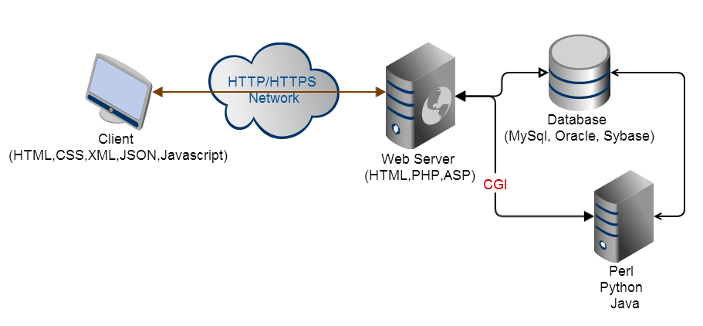
JAVASCRIPT
LIFECYCLE

Slide 4
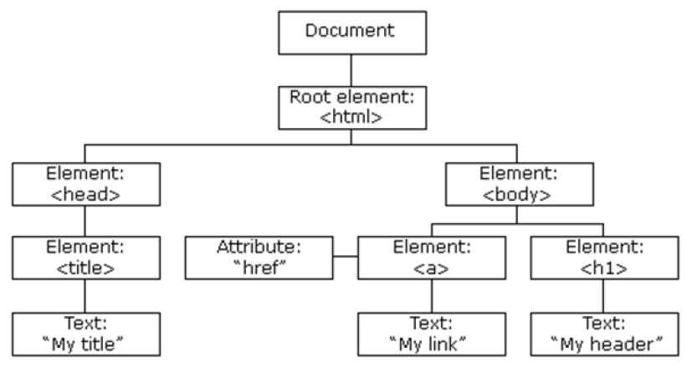
JAVASCRIPT
DOM
HTML Document Object Model (DOM) is constructed as a tree of Objects and allows dynamic HTML/CSS document manipulation.
JavaScript can access all the nodes in the tree

Slide 5
JAVASCRIPT
ADDING IT TO PAGE
Inline
<script type=“text/javascript”>
document.write(“hello”);
</script>
External File
<script type=“text/javascript” src=“myscript.js” ></script>

Slide 6
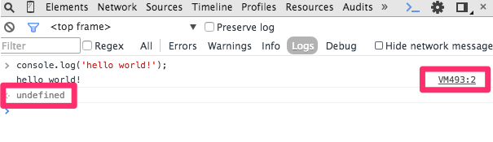
JAVASCRIPT
CONSOLE
console.log(‘hello world!’);
console.debug(‘hello world!’);
console.error(‘hello world!’);

Slide 7
JAVASCRIPT
HTML
<!DOCTYPE html>
<html>
<head>
<title>Hello World</title>
</head>
<body>
<script type="text/javascript">
document.write('hello, world!');
</script>
</body>
</html>
,

Slide 8
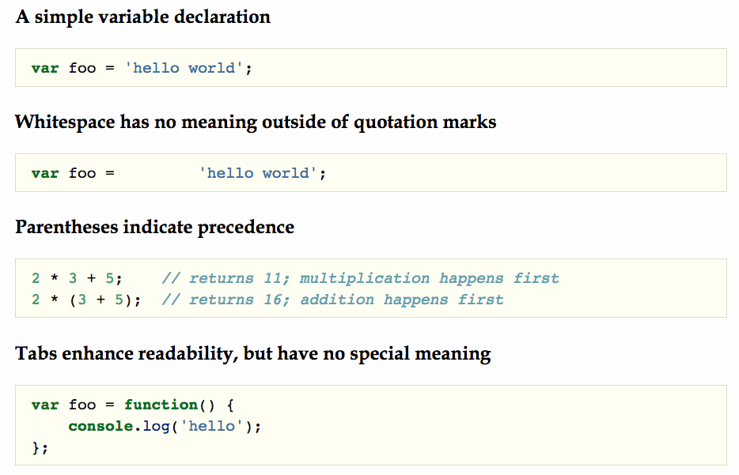
JAVASCRIPT
BASICS
,

Slide 9
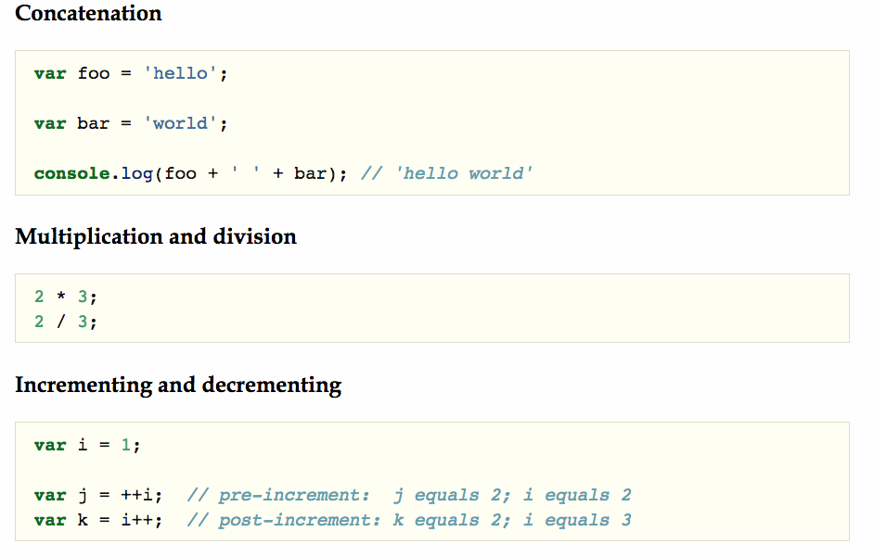
JAVASCRIPT
BASIC OPERATORS
,

Slide 10
jQuery

Slide 11
Other JS frameworks

